Slide 1
Correlation Analysis of Stock and Cryptocurrency Returns
AMS 691 Final Project
Weiwei Tao 05/05/2022

Slide 2
Introduction
The cryptocurrency, born in 2009, was on the fringes of finance from 2016 to 2019, and was barely correlated with the stock market.
The pandemic outbreak required us to re-investigate the relationship between cryptocurrencies and stock market.
We want to answer following questions:
Is the correlations between asset returns change over time?
Are they higher during periods of higher volatility (sometimes associated with financial crises)?
Are they increasing in the long run, perhaps because of the globalization of financial markets?

Slide 3
Data
S&P 500 Index (SPX, Yahoo Finance)
Gold (Yahoo Finance)
Bitcoin (coinmarketcap)
Ethereum (coinmarketcap)
The data covers five years from March 22, 2017 to April 27, 2022. The last one-month data was used as testing dataset to compare observed correlations to predicted correlations using DCC GARCH model.
Notes:
We consider four stock indices and three potential safe haven assets

Slide 4
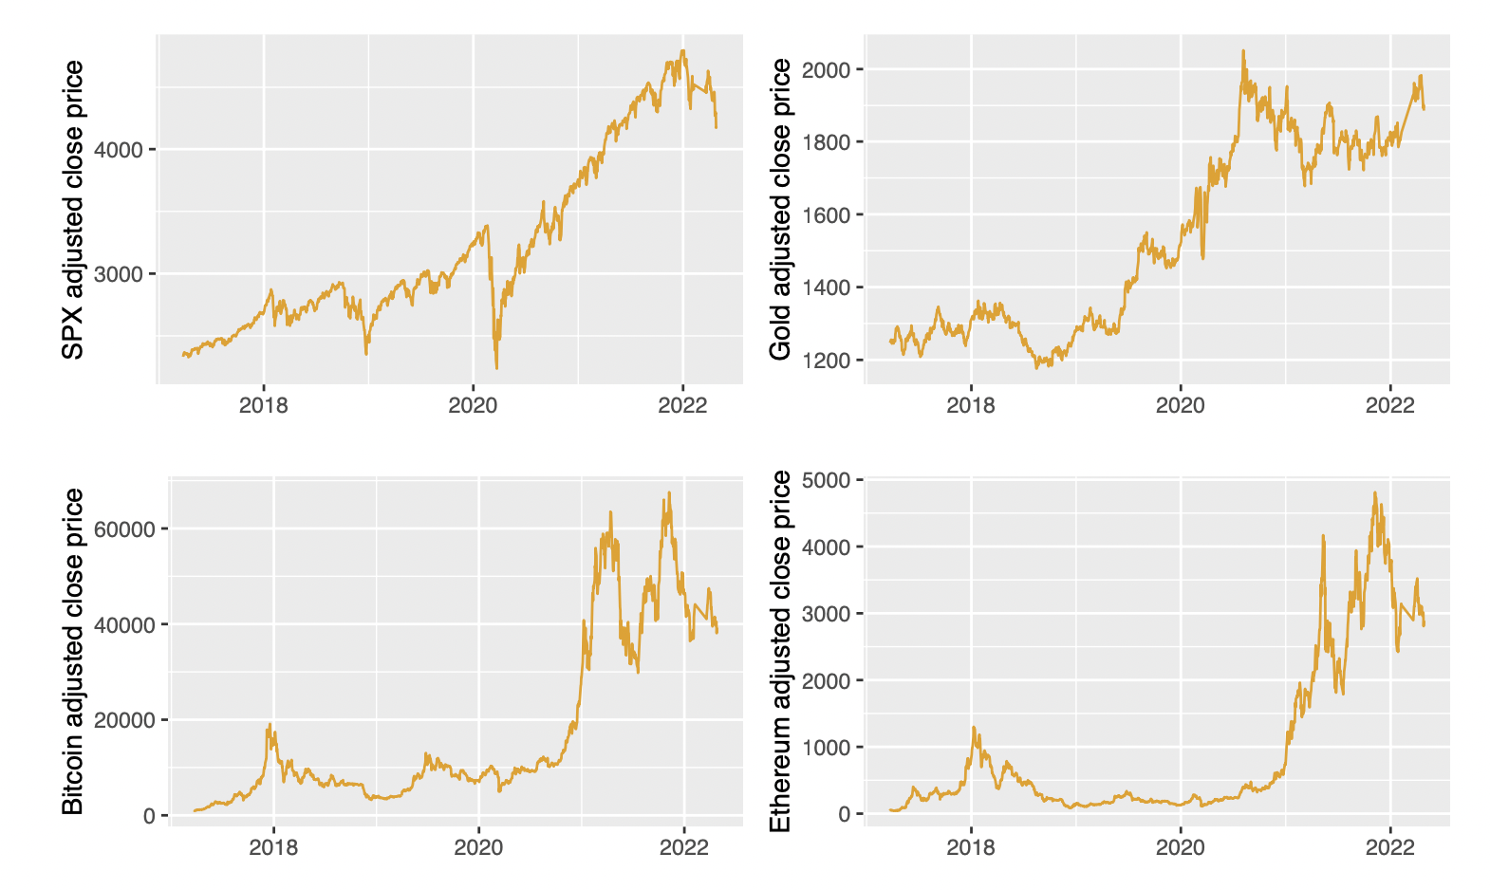
Price Trend
SPX had dramatic price drop in early 2020.
BTC and ETH experienced large price drop in early 2021 and late 2021. SPX show similar trend afterwards.

Slide 5
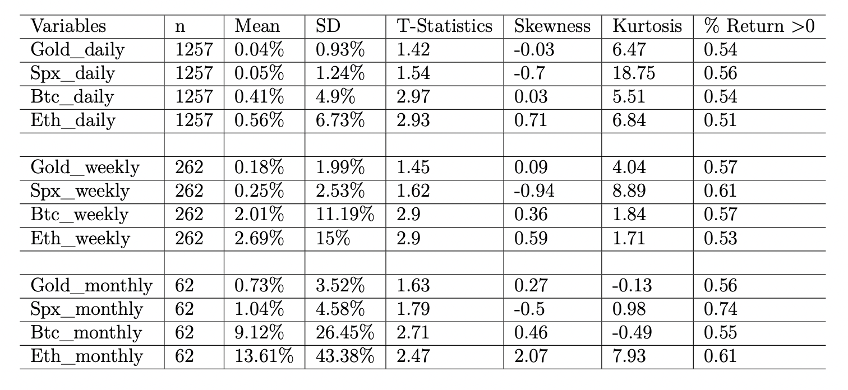
Summary Statistics on Returns
ETH has the highest returns and variations.
BTC and ETH are positively skewed while SPX is left skewed.
SPX has highest percentage of positive returns.

Slide 6
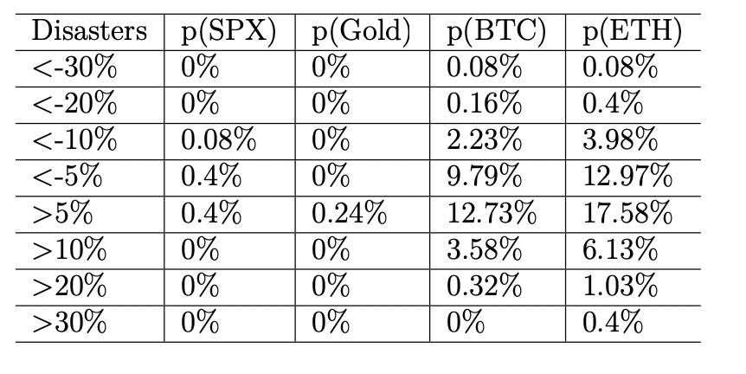
Summary Statistics on Returns
Gold is the most stable with no < -5% daily returns.
The Bitcoin and Ethereum returns have high probabilities of exceptional negative and positive daily returns.

Slide 7
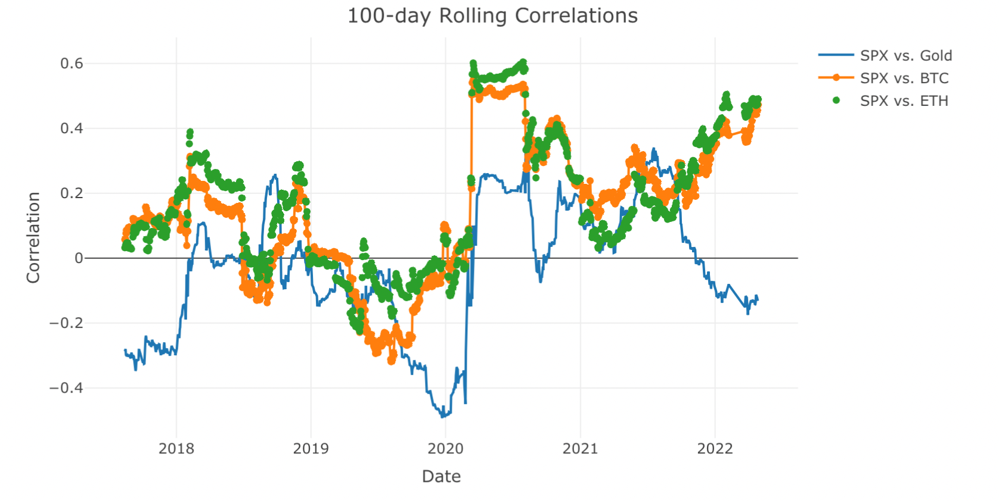
Rolling Correlations between Assets
Correlations between SPX and cryptocurrencies increased dramatically after pandemic outbreak and the value stays high.
Correlations between SPX and gold are around 0.
Notes:
Various ways of testing whether an asset can be a safe haven
Simple methods such as rolling historical correlations and exponential smoothing are widely used.
Rolling correlation gives equal weight to all observations less than n periods in the past.
Exponential smoother uses declining weights based on a parameter rata.
the multivariate ARCH models (MARCH) have attracted a lot of attention in modern finance theory and enjoyed voluminous empirical applications;

Slide 8
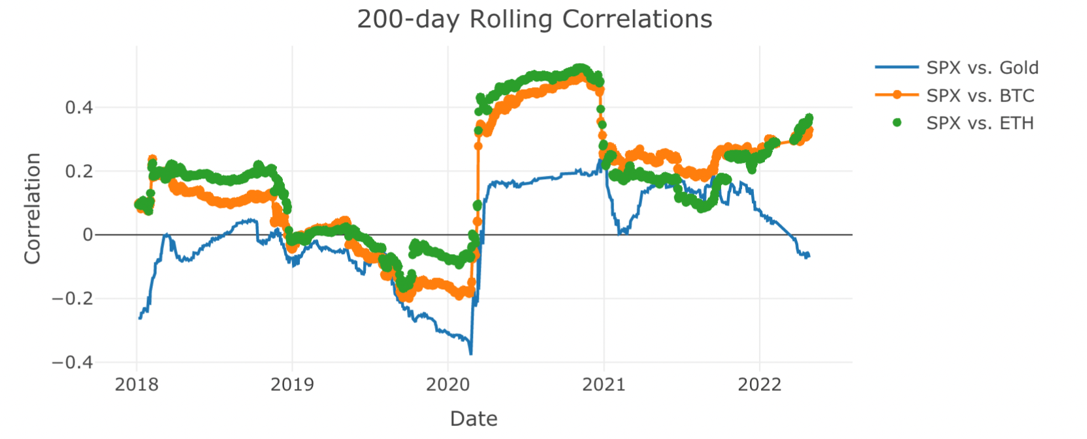
Rolling Correlations between Assets

Slide 9
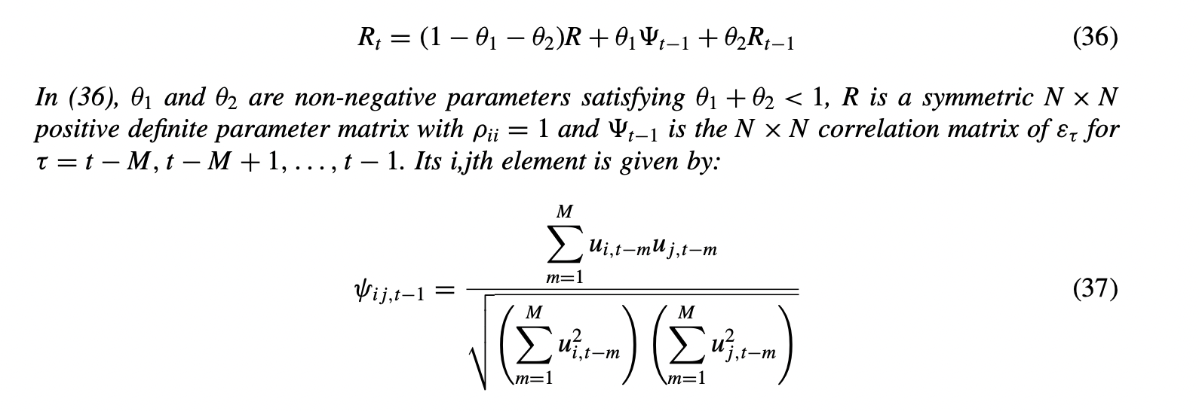
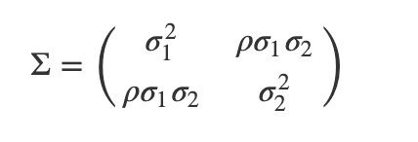
DCC-GARCH Model
Need method to model the multivariate distribution of two assets returns and their dynamic correlations.
DCC-GARCH model fit covariance matrix as linear combination of lagged covariance matrix and correlation matrix of standardized disturbance.
Source: Bauwens et al., 2006, Multivariate GARCH Model: a survey
Notes:
We use multivariate GARCH model to study the relations between the volatilities and co-volatilities of each of the two assets returns, where the multivariate distribution of the returns can be used directly to compute the implied dynamic correlations. DCC-GARCH model allows the conditional-on-past-history covariance matrix where covariance matrix can be modeled as linear combination of lagged covariance matrix and correlation matrix.

Slide 10
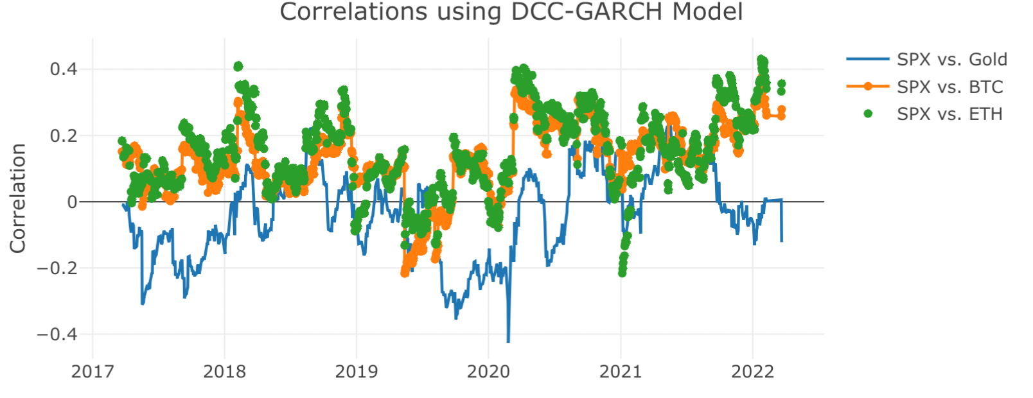
DCC-GARCH Model
Conditional correlations are less extreme than rolling correlations.
The correlations between SPX and cryptocurrencies are ALMOST ALWAYS greater than 0 after pandemic outbreak.
Notes:
DCC MSV model allows for two sources of variability
In the Bayesian approach, the distribution of all random variables are modeled.

Slide 11
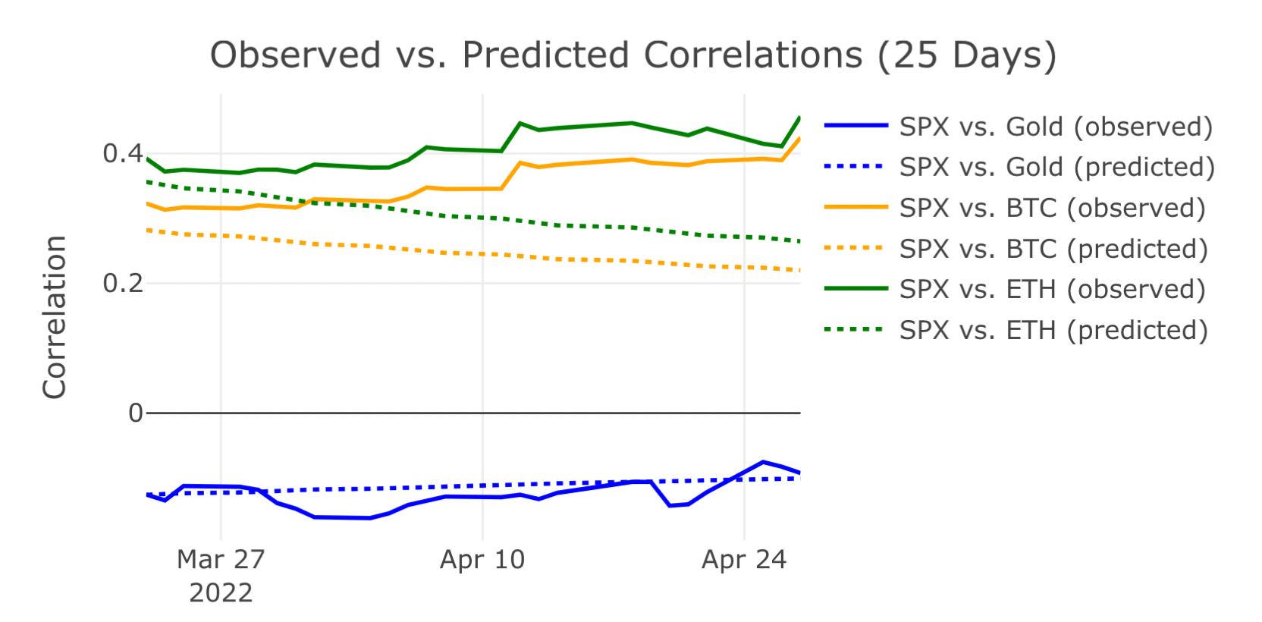
DCC-GARCH Model
DCC-GARCH model gives good short-term (one week) predictions in correlations.
Prediction error increases in SPX vs. BTC and SPX vs. ETH correlations as time increases.
Notes:
DCC MSV model allows for two sources of variability
In the Bayesian approach, the distribution of all random variables are modeled.

Slide 12
Conclusion
Correlation between gold and S&P 500 returns are always around 0 even after pandemic outbreak.
Since early 2020, correlations between SPX and cryptocurrencies stays high.
The correlations are higher during periods of higher volatility (early 2020 and early 2022).
ETH shows highest correlation with SPX as comparing to BTC and gold.
DCC-GARCH provides nice short-term prediction in conditional correlation.

Slide 13
Thanks for listening!
Questions? Comments?

